Slide 1
Object Orientation
Dr. Charles R. Severance
www.cc4e.com

Slide 2
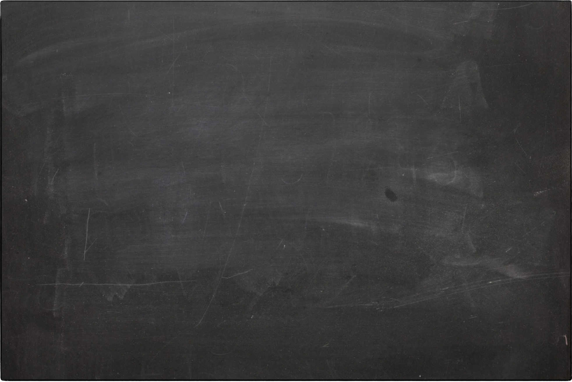
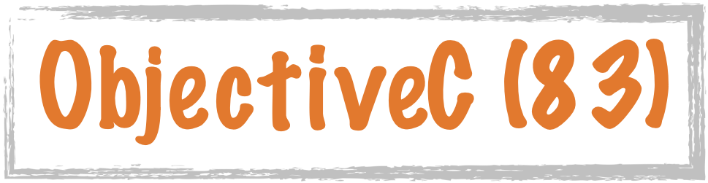




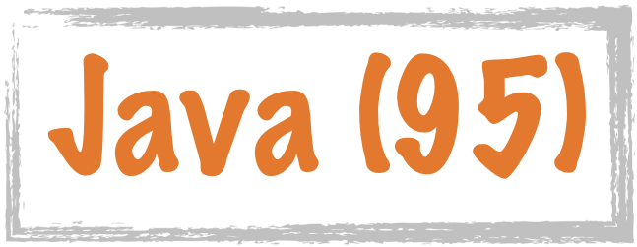



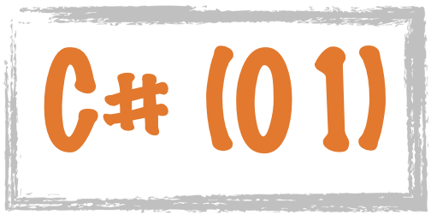

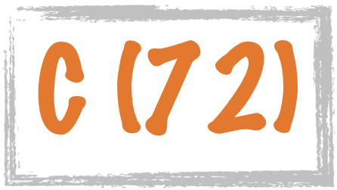
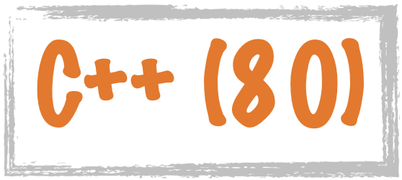




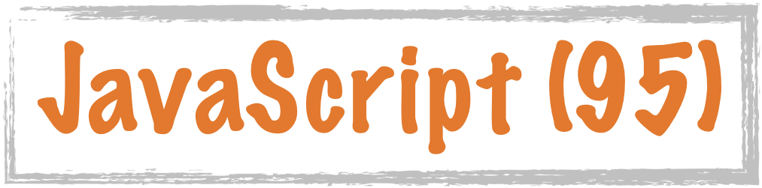




Science Calculations
System
System
C uses curly braces { } for code blocks.
Scripting/
Interpreted
http://en.wikipedia.org/wiki/History_of_programming_languages

Slide 3






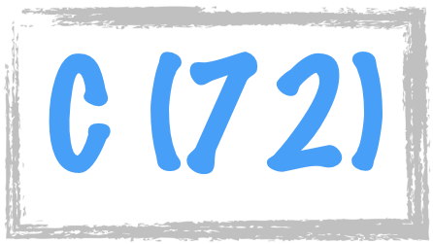


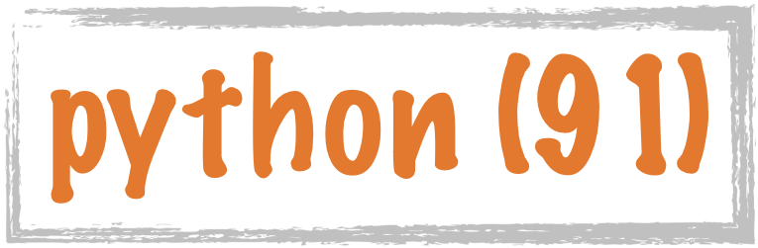





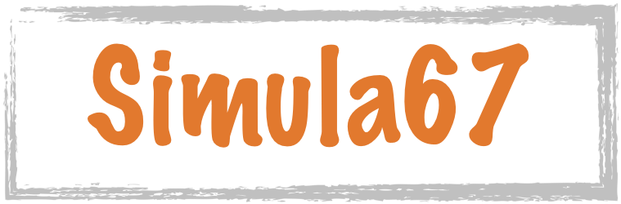











Procedural
Hybrid
Object Oriented
Classes were added to PHP in 2000
https://en.wikipedia.org/wiki/Object-oriented_programming

